Slide 1

Mobile App Design Process
Research, Design, Implementation: Agile Process for Mobility

Slide 2
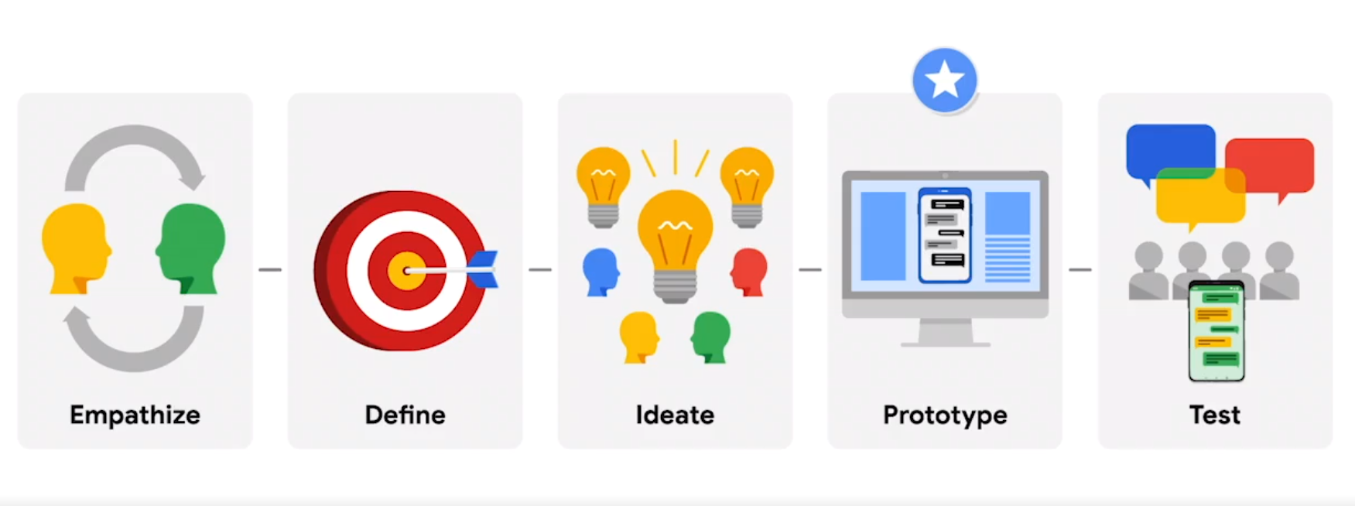
Next…

Slide 3
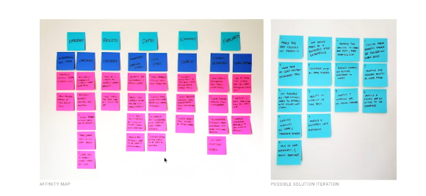
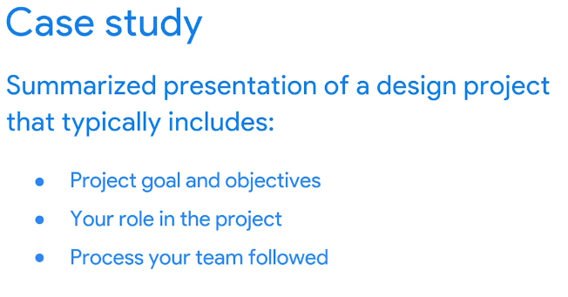
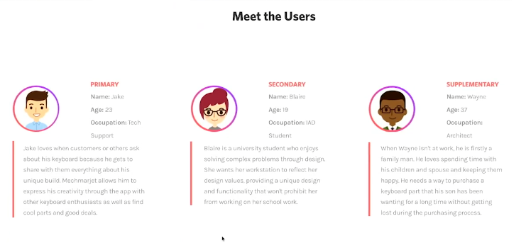
Create a case study for your portfolio project

Slide 4
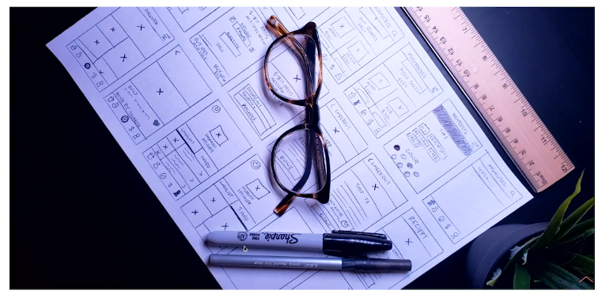
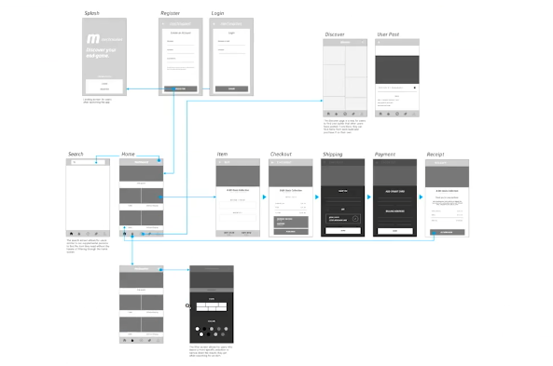
Create a case study for your portfolio project

Slide 5
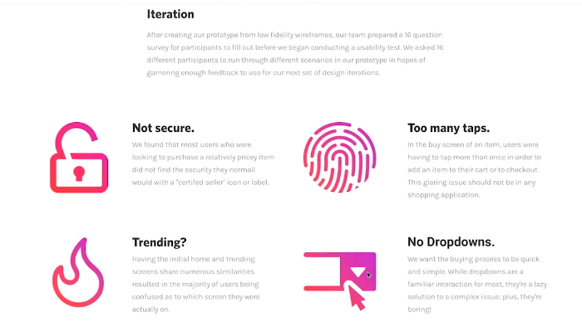
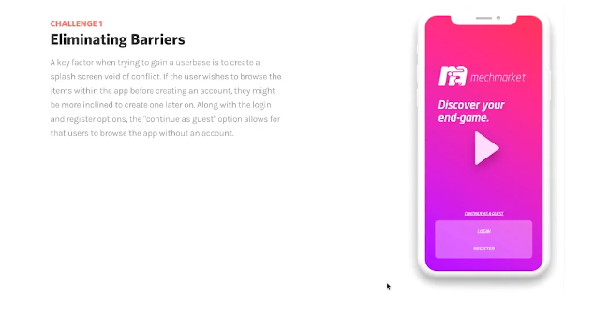
Create a case study for your portfolio project

Slide 6
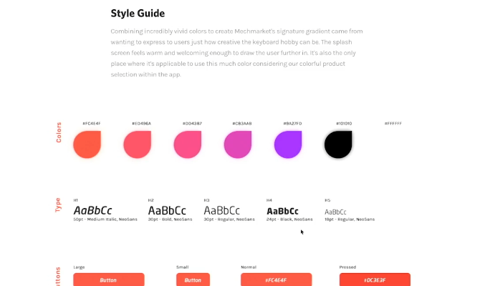
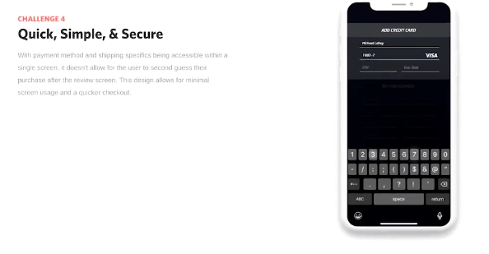
Create a case study for your portfolio project

Slide 7
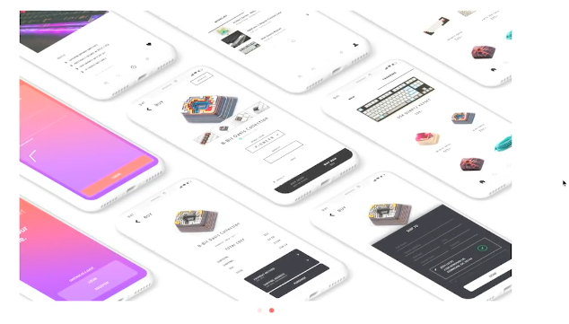
Create a case study for your portfolio project

Slide 8

INTRODUCING EVALUATION

Slide 9
Goals
Explain the key concepts and terms used in evaluation
Introduce range of different types of evaluation methods
Show how different evaluation methods are used for different purposes at different stages of the design process and in different contexts of use
Show how evaluators mixed and modified to meet the demands of evaluating novel systems
Notes:
9

Slide 10
Goals (continued)
Discuss some of the practical challenges of doing evaluation
Through case studies, illustrate how methods discussed in Chapters 8, 9, and 10 are used in evaluation, and describe some methods that are specific to evaluation
Provide an overview of methods that are discussed in detail in the next two chapters
Notes:
10

Slide 11
Why, what, where, and when to evaluate
Iterative design and evaluation is a continuous process that examines:
Why: To check users’ requirements and confirm that users can utilize the product and that they like it
What: A conceptual model, early and subsequent prototypes of a new system, more complete prototypes, and a prototype to compare with competitors’ products
Where: In natural, in-the-wild, and laboratory settings
When: Throughout design; finished products can be evaluated to collect information to inform new products
Notes:
11

Slide 12
Bruce Tognazzini tells you why you need to evaluate
“Iterative design, with its repeating cycle of design and testing, is the only validated methodology in existence that will consistently produce successful results. If you don’t have user-testing as an integral part of your design process you are going to throw buckets of money down the drain.”
See AskTog.com for topical discussions about design and evaluation
Notes:
12

Slide 13
Types of evaluation
Controlled settings that directly involve users (for example, usability and research labs)
Natural settings involving users (for instance, online communities and products that are used in public places)
  Often there is little or no control over what users do, especially in in-the-wild settings
Any setting that doesn’t directly involve users (for example, consultants and researchers critique the prototypes, and may predict and model how successful they will be when used by users
Notes:
13

Slide 14
Living labs
People’s use of technology in their everyday lives can be evaluated in living labs
Such evaluations are too difficult to do in a usability lab
An early example was the Aware Home that was embedded with a complex network of sensors and audio/video recording devices (Abowd et al., 2000)

Slide 15
Living labs (continued)
More recent examples include whole blocks and cities that house hundreds of people, for example, Verma et al., research in Switzerland (2017)
Many citizen science projects can also be thought of as living labs, for instance, iNaturalist.org
These examples illustrate how the concept of a lab is changing to include other spaces where people’s use of technology can be studied in realistic environments

Slide 16
Evaluation case studies
A classic experimental investigation into the physiological responses of players of a computer game
An ethnographic study of visitors at the the Royal Highland show in which participants are directed and tracked using a mobile phone app
Crowdsourcing in which the opinions and reactions of volunteers (for example, from the crowd) inform technology evaluation
Notes:
16

Slide 17
Challenge and engagement in a collaborative immersive game
Physiological measures were used
Players were more engaged when playing against another person than when playing against a computer
Why was the physiological data collected normalized?
Notes:
17

Slide 18
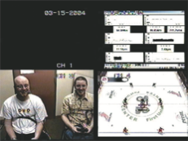
Physiological data of participants in a videogame
Source: Mandryk and Inkpen (2004), “The Physiological Indicators for the Evaluation of Co-located Collaborative Play,” CSCW’2004, pp 102-111. Reproduced with permission of ACM Publications.
Notes:
18

Slide 19
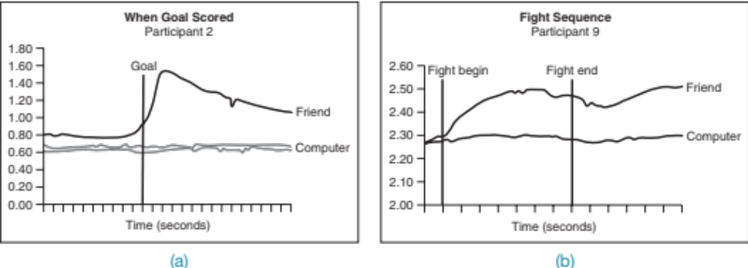
Example of physiological data
A participants’ skin response when scoring a goal against a friend (a), and another participants’ response when when engaging in a hockey fight against a friend versus against the computer (b).
Source: Mandryk and Inkpen (2004), “The Physiological Indicators for the Evaluation of Co-located Collaborative Play,” CSCW’2004, pp 102-111. Reproduced with permission of ACM Publications.
Notes:
19

Slide 20
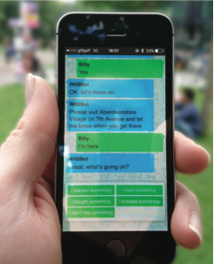
Ethnobot app used at the Royal Highland Show
The Ethnobat directed Billy to a particular place (Aberdeenshire Village)
Next, Ethnobot asks “…what’s going on?”
The screen shows five of the experience buttons from which Billy needs to select a response
Source: Tallyn et al. (2018) Reproduced with permission of ACM Publications.

Slide 21
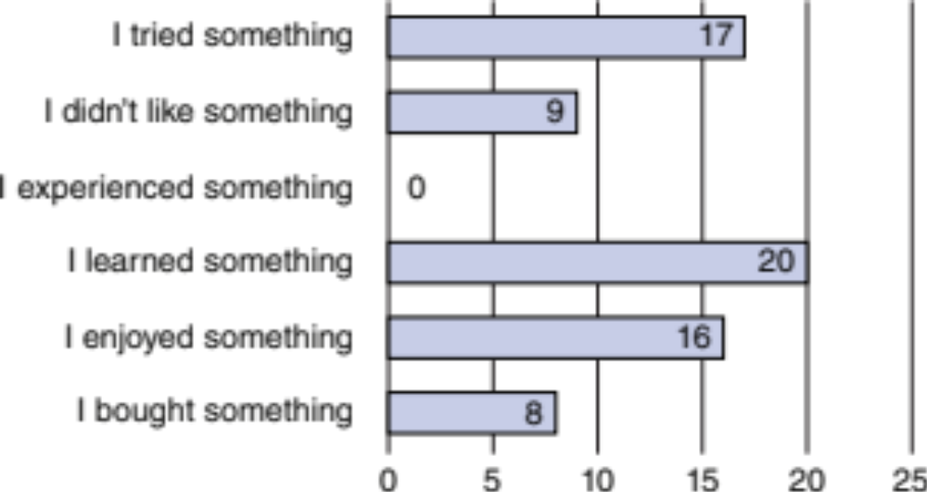
Experience responses submitted in Ethnobot
Number of prewritten experience responses submitted by participants to the pre-established questions that Ethnobot asked them about their experiences
Source: Tallyn et al. (2018) Reproduced with permission of ACM Publications.

Slide 22
What did we learn from the case studies?
How to observe users in the lab and in natural settings
How evaluators excerpt different levels of control in the lab and in natural settings and in crowdsourcing evaluation studies
Use of different evaluation methods

Slide 23
What did we learn from the case studies? (continued)
How to develop different data collection and analysis techniques to evaluate user experience goals such as challenge and engagement
The ability to run experiments on the Internet that are quick and inexpensive using crowdsourcing
How a large number of participants can be recruited using Mechanical Turk

Slide 24
Evaluation methods
Method | Controlled settings | Natural settings | Without users
Observing | x | x
Asking users | x | x
Asking experts |  | x | x
Testing | x
Modeling |  |  | x
Notes:
24

Slide 25
The language of evaluation
Analytics
Analytical evaluation
Biases
Controlled experiment
Crowdsourcing
Ecological validity
Expert review or criticism
Field study
Formative evaluation
Heuristic evaluation
Informed consent form
In the wild evaluation
Living laboratory
Predictive evaluation
Reliability
Scope
Summative evaluation
Usability laboratory
User studies
Usability testing
Users or participants
Validity
Notes:
25

Slide 26
Participants’ rights and getting their consent
Participants need to be told why the evaluation is being done, what they will be asked to do and informed about their rights
Informed consent forms provide this information and act as a contract between participants and researchers
The design of the informed consent form, the evaluation process, data analysis, and data storage methods are typically approved by a high authority, such as the Institutional Review Board

Slide 27
Things to consider when interpreting data
Reliability: Does the method produce the same results on separate occasions?
Validity: Does the method measure what it is intended to measure?
Ecological validity: Does the environment of the evaluation distort the results?
Biases: Are there biases that distort the results?
Scope: How generalizable are the results?

Slide 28
Summary
Evaluation and design are very closely integrated
Some of the same data gathering methods are used in evaluation as for establishing requirements and identifying users’ needs, for example, observation, interviews, and questionnaires
Evaluations can be done in controlled settings such as laboratories, less controlled field settings, or where users are not present

Slide 29
Summary (continued)
Usability testing and experiments enable the evaluator to have a high level of control over what gets tested, whereas evaluators typically impose little or no control on participants in field studies
Different methods can be combined to get different perspectives
Participants need to be made aware of their rights
It is important not to over-generalize findings from an evaluation

Slide 30

Evaluation Studies:
From Controlled to Natural Settings

Slide 31
Goals
• Explain how to do usability testing
• Outline the basics of experimental design
• Describe how to do field studies
Notes:
31

Slide 32
Usability testing
Involves recording performance of typical users doing typical tasks
Controlled settings
Users are observed and timed
Data is recorded on video, and key presses are logged
The data is used to calculate performance times and to identify and explain errors
User satisfaction is evaluated using questionnaires and interviews
Field observations may be used to provide contextual understanding
Notes:
32

Slide 33
Quantitative performance measures
Number of users successfully completing the task
Time to complete task
Time to complete task after time away from task
Number and type of errors per task
Number of errors per unit of time
Number of navigations to online help or manuals
Number of users making a particular type of error
Source: Wixon and Wilson, 1997
Notes:
33

Slide 34
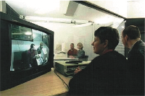
Usability lab with observers watching a user and assistant

Slide 35
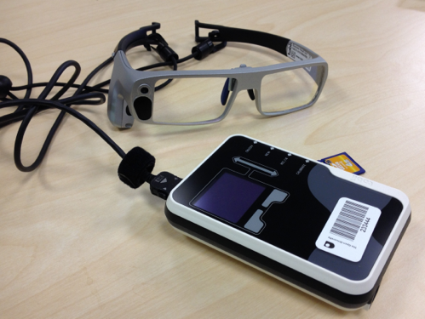
Tobii Glasses Mobile Eye-Tracking System
Source: Dalton et al., 2015, p.3891. Reproduced with permission of ACM Publications.

Slide 36
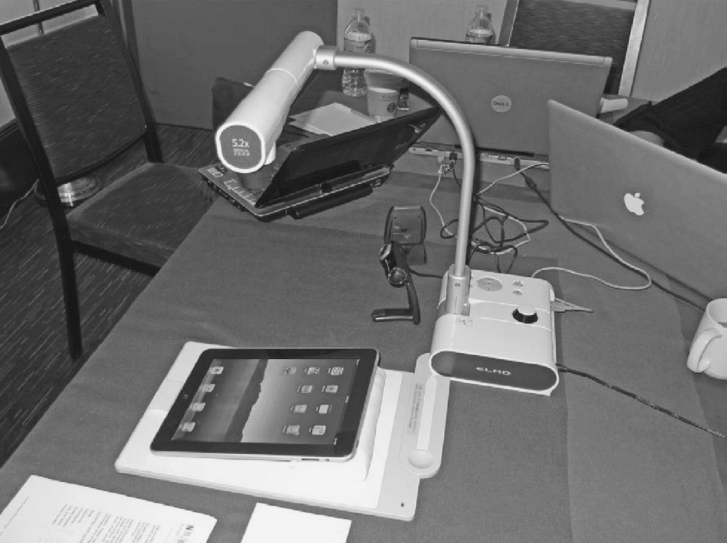
Portable equipment for use in the field
Setup used in the Chicago usability testing sessions
Source: iPad App and Website Usability Study. Used courtesy of the Neilsen Norman Group.

Slide 37
Testing the iPad usability
First study was conducted quickly in two cities: Fremont, CA and Chicago, IL
Tests had to be done quickly, as information was needed by third-party app developers
Also needed to be done secretly so that the competition was not aware of the study before the iPad was launched
Seven participants with over three months experience with iPhones

Slide 38
Testing the iPad usability (continued)
Signed an informed consent form explaining:
  What the participant would be asked to do
  The length of time needed for the study
  The compensation that would be offered for participating
  Participants’ right to withdraw from the study at any time
  A promise that the person’s identity would not be disclosed
  An agreement that the data collected would be confidential and available to only the evaluators
Participants were asked to explore the iPad
Next, they were asked to perform randomly-assigned specified tasks

Slide 39
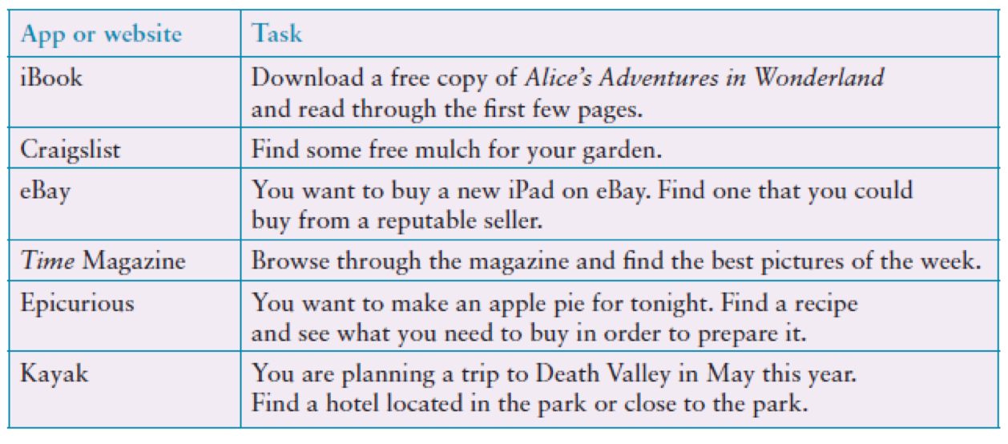
Examples of the tasks used in the iPad evaluation
Adapted from Budiu and Nielsen, 2010
Source: iPad App and Website Usability Study. Used courtesy of the Neilsen Norman Group.

Slide 40
Problems and actions
Examples of problems detected:
  Accessing the Web was difficult
  Lack of affordance and feedback
  Getting lost in an application
  Knowing where to tap
Actions by evaluators:
  Reported to developers
  Made available to public on Neilsen Norman Group.

Slide 41
Problems and actions (continued)
Accessibility for all users is important
Study did not address how iPad would be used in people’s everyday lives
Another study was done a year later to examine this and other issues that there was insufficient time to address in the first study

Slide 42
Usability testing conditions
Usability lab or other controlled space
Emphasis on:
  Selecting representative users
  Developing representative tasks
5-10 users typically selected
Tasks usually around 30 minutes
Test conditions are the same for every participant
Informed consent form explains procedures and deals with ethical issues
Notes:
42

Slide 43
How many participants is enough for user testing?
The number is a practical issue
Depends on:
  Schedule for testing
  Availability of participants
  Cost of running tests
Typically 5-10 participants
Some experts argue that testing should continue until no new insights are gained
Notes:
43

Slide 44
Usability testing and Experiments
Usability testing is applied experimentation
Developers check that the system is usable by the intended user population by collecting data about participants’ performance on prescribed tasks
Experiments test hypotheses to discover new knowledge by investigating the relationship between two or more variables
Notes:
44

Slide 45
Usability testing and research
Usability Testing
Improve products
Few participants
Results inform design
Usually not completely replicable
Conditions controlled as much as possible
Procedure planned
Results reported to developers
Experiments for Research
Discover knowledge
Many participants
Results validated statistically
Must be replicable
Strongly controlled conditions
Experimental design
Scientific report to scientific community
Notes:
45

Slide 46
Experiments
Test hypothesis
Predict the relationship between two or more variables
Independent variable is manipulated by the researcher
Dependent variable influenced by the independent variable
Typical experimental designs have one or two independent variables
Validated statistically and replicable
Notes:
46

Slide 47
Experimental designs
Different participants (between subjects):
Single group of participants is allocated randomly to the experimental conditions
Same participants (within subjects):
All participants appear in both conditions
Matched participants (pairwise):
Participants are matched in pairs, for example, based on expertise, gender, and so on
Notes:
47

Slide 48
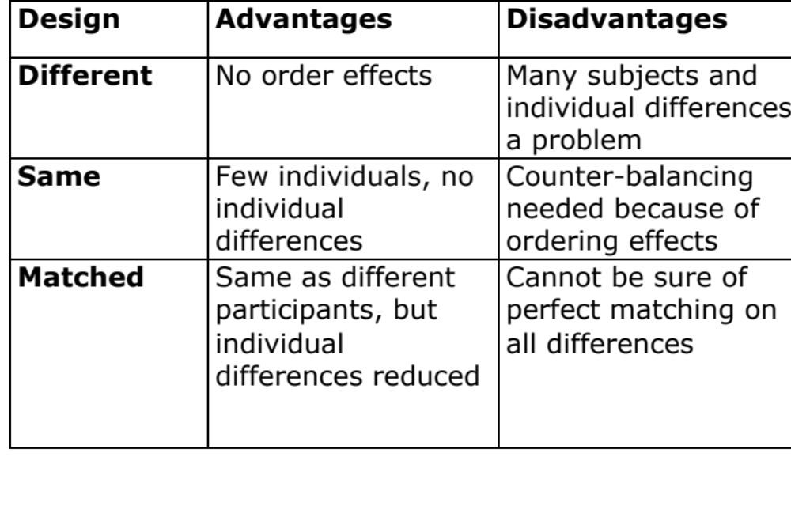
Different, same, matched participant design
Notes:
48

Slide 49
Field studies
Field studies are done in natural settings
“In the wild” is a term for prototypes being used freely in natural settings
Seek to understand what users do naturally and how technology impacts them
Field studies are used in product design to:
  Identify opportunities for new technology
  Determine design requirements
  Decide how best to introduce new technology
  Evaluate technology in use
Notes:
49

Slide 50
A field study of a pain-monitoring device
Monitoring patients’ pain is a known challenge for physicians
Goal of the study was to evaluate the use of a pain-monitoring device for use after ambulatory surgery
Painpad is a keypad device
It was usability tested extensively in the lab before brought into two hospitals
Goal was to understand how Painpad was used in the natural environment and as part of routines in two UK hospitals.
How pain-monitoring differed with Painpad
Notes:
50

Slide 51
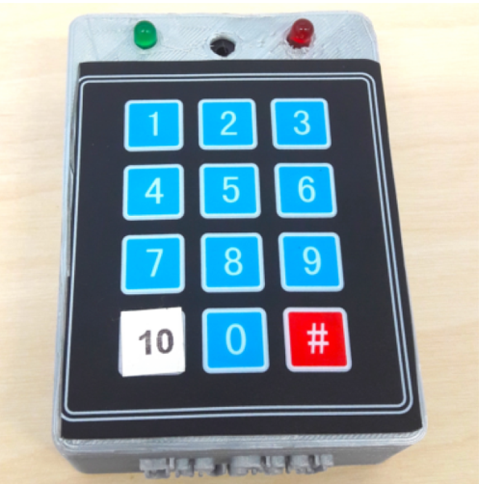
Painpad
A tangible device for inpatient self-logging of pain
Source: Price et al., 2018. Reproduced with permission of ACM Publications.

Slide 52
Data collection and participants
Two studies in two hospitals involving 54 people
13 males, 41 females
Privacy was a important concern
Hospital stay ranged from 1-7 days, mean and median age 64.6, 64.5
Patients given Painpad after surgery and prompted to report pain levels every two hours
Nurses also collected scores
All data entered into charts
Patients in one hospital were given a user-satisfaction survey when they left
Also rated Painpad on a 1-5 Likert scale
Notes:
52

Slide 53
Data analysis and presentation
Three types of data were collected:
  Satisfaction with Painpad was based on questionnaire responses
  Patients’ compliance with the two-hour routine
  How data collected from Painpad compared with data collected by nurses
Data showed:
  Satisfaction with Painpad 4.63 on Likert scale
  Patience compliance was mixed: some liked it while others disliked or didn’t notice the prompts
  Patients recorded more scores with Painpad than through the nurses

Slide 54
Summary
Usability testing takes place in controlled usability labs or temporary labs
Usability testing focuses on performance measures, for example, how long and how many errors are made when completing a set of predefined tasks
Indirect observation (video and keystroke logging), user satisfaction questionnaires, and interviews are also collected
Affordable, remote testing systems are more portable than usability labs
Many also contain mobile eye-tracking and other devices
Notes:
54

Slide 55
Summary (continued)
Experiments test a hypothesis by manipulating certain variables while keeping others constant
The experimenter controls independent variable(s) in order to measure dependent variable(s)
Field studies are evaluation studies that are carried out in natural settings to discover how people interact with technology in the real world
Field studies that involve the deployment of prototypes or technologies in natural settings may also be referred to as ‘in-the-wild’ studies
Sometimes the findings of a field study are unexpected, especially for in-the-wild studies that explore how novel technologies are used by participants in their own homes, places of work, or outside
Notes:
55

Slide 56
Evaluation: Inspections, Analytics, and Models

Slide 57
Goals
Describe the key concepts associated with inspection methods
Explain how to do heuristic evaluation and walkthroughs
Explain the role of analytics in evaluation
Describe how A/B testing is used in evaluation
Describe how to use Fitts’ Law – a predictive model
Notes:
57

Slide 58
Inspections
Several kinds
Experts use their knowledge of users and technology to review software usability
Expert critiques can be formal or informal
Heuristic evaluation is a review guided by a set of heuristics
Walkthroughs involve stepping through a pre-planned scenario noting potential problems
Notes:
58

Slide 59
Heuristic evaluation
Developed by Jacob Nielsen in the early 1990s
Based on heuristics distilled from an empirical analysis of 249 usability problems
These heuristics have been revised for current technology by Nielsen and others for:
  Mobile devices
  Wearables
  Virtual worlds
  Social media
  …
Design guidelines form a basis for developing heuristics
Notes:
59

Slide 60
Revised version (2014) of Nielsen’s original heuristics (continued)
Recognition rather than recall
Flexibility and efficiency of use
Aesthetic and minimalist design
Help users recognize, diagnose, recover from errors
Help and documentation
Notes:
60

Slide 61
Revised version (2014) of Nielsen’s original heuristics
Visibility of system status
Match between system and real world
User control and freedom
Consistency and standards
Error prevention
Notes:
61

Slide 62
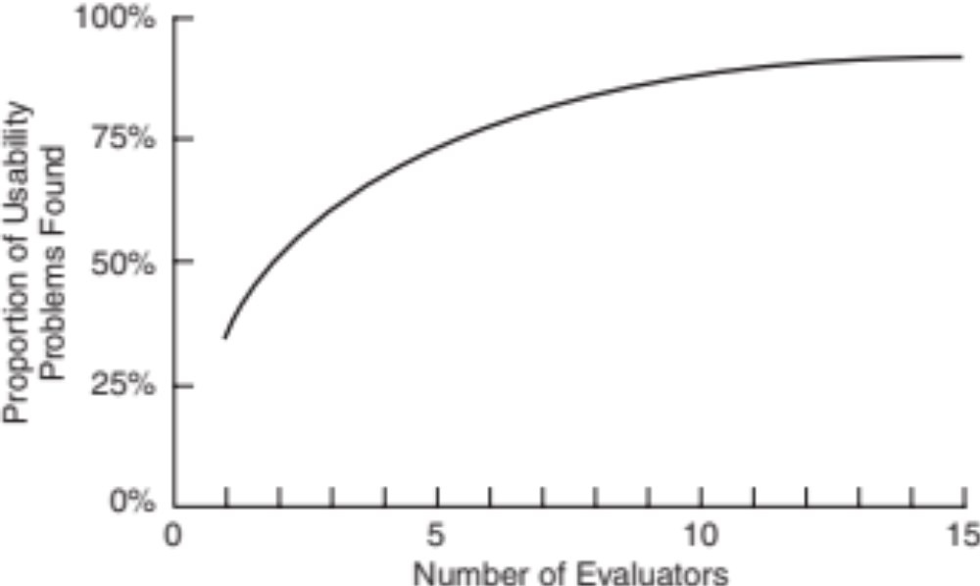
Number of evaluators and problems
Curve showing the proportion of usability problems in an interface found by heuristic evaluation using different numbers of evaluators
Source: Nielsen and Mack, 1994. Courtesy of Wiley.
Notes:
62

Slide 63
Number of evaluators
Nielsen suggests that on average five evaluators identify 75-80 percent of usability problems
Cockton and Woolrych (2001) point out that the number of users needed to find 75-80 percent of usability problems depends on the context and nature of the task problems
Notes:
63

Slide 64
Heuristics for websites focus on key criteria
Clarity
Minimize unnecessary complexity and cognitive load
Provide users with context
Promote positive and pleasurable user experience
Source: Budd, 2007

Slide 65
Doing heuristic evaluation
Briefing session to tell experts what to do
Evaluation period of 1-2 hours in which:
  Each expert works separately
  Take one pass to get a feel for the product
  Take a second pass to focus on specific features
  Debriefing session in which experts work together to prioritize problems
Notes:
65

Slide 66
Advantages and problems
Few ethical and practical issues to consider because users not involved
Can be difficult and expensive to find experts
Best experts have knowledge of application domain and users
Biggest problems:
  Important problems may get missed
  Many trivial problems are often identified, such as false alarms
  Experts have biases
Notes:
66

Slide 67
Turning design guidelines and golden rules into heuristics
Ask questions like the following:
“Does the application include a visible title page, section or site? Does the user always know where they are located? Does the user always know what the system or application is doing? Are the links clearly defined? Can all actions be visualized directly (i.e., no other actions are required)?”
Granollers, 2018, p. 62
Notes:
67

Slide 68
Evaluating for accessibility using Guidelines
Web Content Accessibility Guidelines (WCAG) (see Lazar et al., 2015)
Guidelines can be used as heuristics for evaluating websites
Governments and large corporations have to make their websites accessible by law
Four key concepts:
  Perceivable
  Operable
  Understandable
  Robust
Source: WCAG 2.1 at a Glance.
Notes:
68

Slide 69
Cognitive walkthroughs
Focus on ease of learning
Designer presents an aspect of the design and usage scenarios
Expert is told the assumptions about user population, context of use, task details
One or more experts walk through the design prototype with the scenario
Experts are guided by three questions
Notes:
69

Slide 70
The three questions
Will the correct action be sufficiently evident to the user?
Will the user notice that the correct action is available?
Will the user associate and interpret the response from the action correctly?
As the experts work through the scenario, they note problems
Notes:
70

Slide 71
Pluralistic walkthrough
Variation on the cognitive walkthrough theme
Performed by a carefully managed team
The panel of experts begins by working separately
This is followed by a managed discussion that leads to agreed decisions
The approach lends itself well to participatory design
Also other adaptations of basic cognitive walkthroughs
Notes:
71

Slide 72
Web Analytics
A form of interaction logging that analyzes users’ activities on website
Designers use the analysis to improve their designs
When designs don’t meet users’ needs, they will not return to the site
They become one-time users
Notes:
72

Slide 73
Web Analytics (continued)
Web analytics enable designers to track the activities of users on their site
They can see how many people come to the site, how long they stay, and where they go
Web analytics offer designers the “big picture” about how their site performs based on user activity
One of the most well-known analytics
Notes:
73

Slide 74
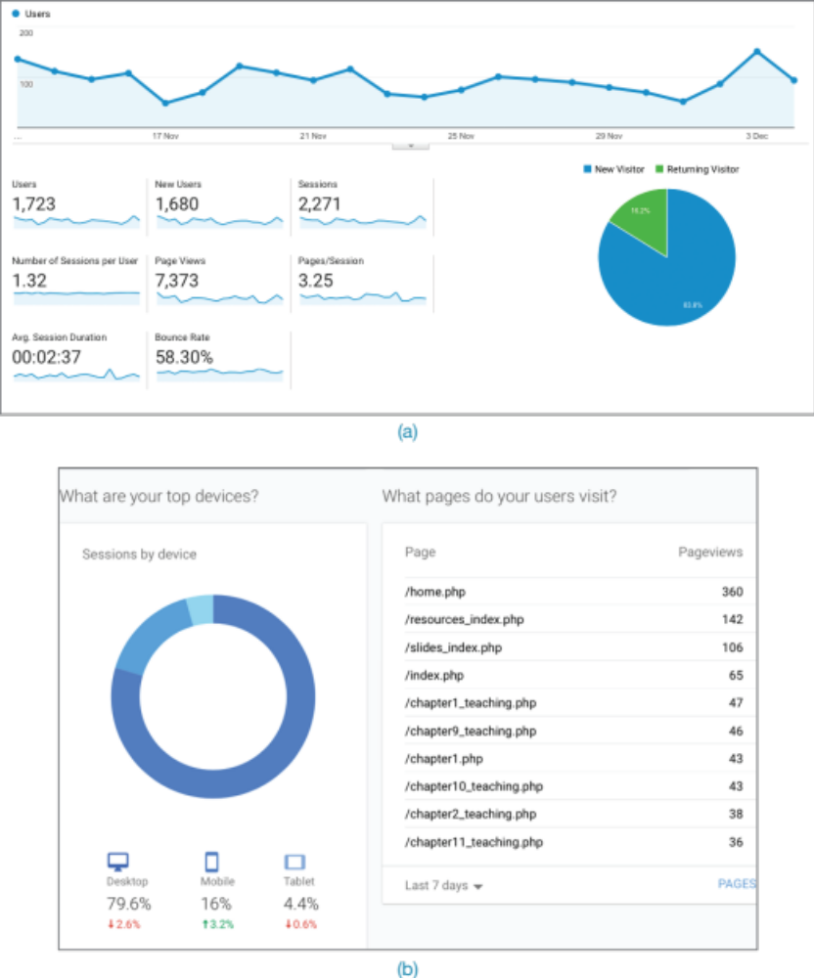
Segment of Google Analytics for Interaction Design 5e website, December 2018

Slide 75
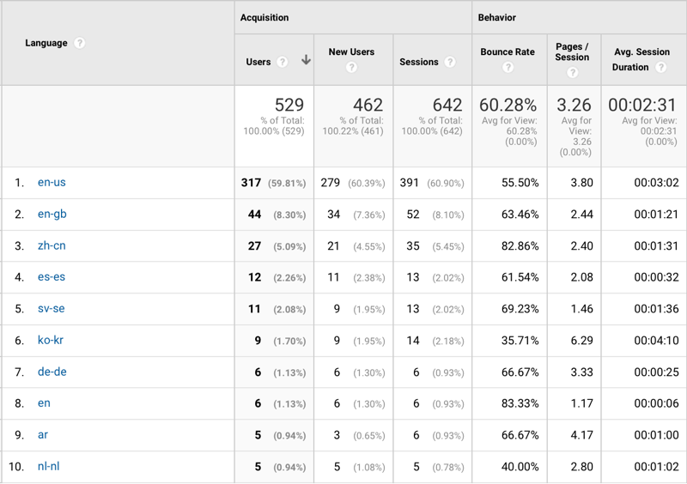
Segment of Google Analytics for Interaction Design 5e website, December 2018 (continued)

Slide 76
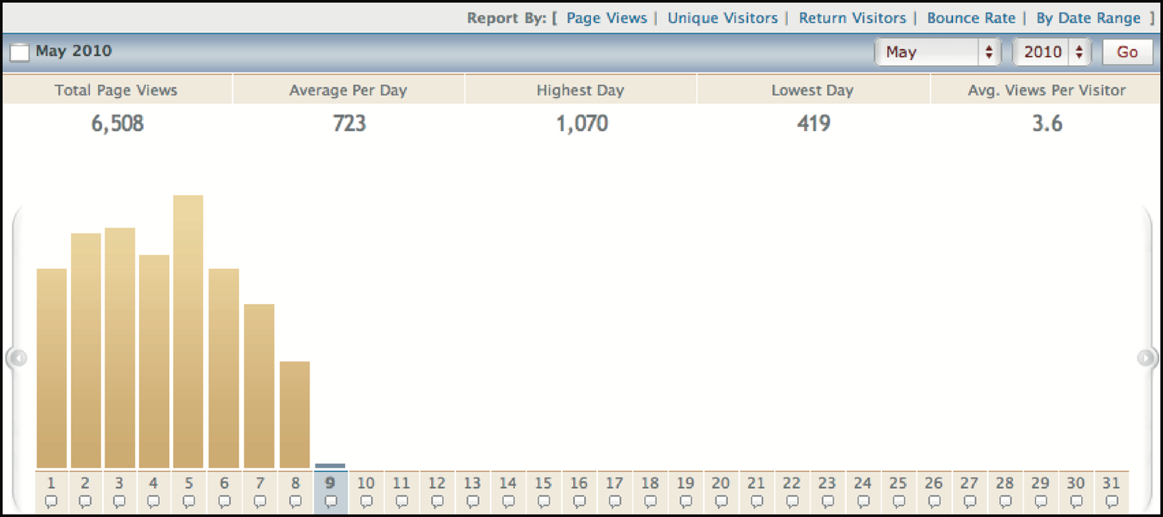
Segment of early VisiStat Analytics from 2010
Source: VisiStat Analytics, 2010

Slide 77
Segment of early VisiStat Analytics from 2010 (continued)
Where visitors to Mountain Wineries in California come from
Source: VisiStat Analytics, 2010

Slide 78
A/B Testing
A large-scale experiment
Offers another way to evaluate a website, application of app running on a mobile device
Often used for evaluating changes in design on social media applications
Compares how two groups of users perform on two versions of a design
Notes:
78

Slide 79
A/B Testing (continued)
Can involve thousands of users
May create ethical dilemmas if users don’t know they are part of the test
Care is needed to ensure that other issues are not affecting users’ behavior
Notes:
79

Slide 80
Predictive models
Provide a way of evaluating products or designs without directly involving users
Less expensive than user testing
Usefulness limited to systems with predictable tasks, for example, voicemail systems, smartphones, and dedicated mobile devices
Based on expert error-free behavior
Notes:
80

Slide 81
Fitts’ Law (1954)
Fitts’ Law predicts that the time to point at an object using a device is a function of the distance from the target object and the object’s size
The further away and the smaller the object, the longer the time to locate it and point to it
It is particularly useful for determining where on a screen to position an object
Fitts’ Law is useful for evaluating systems for which the time to locate an object is important, for example, smartphones, handhelds, and mobile devices
Notes:
81

Slide 82
Summary
Inspections can be used to evaluate requirements, mockups, functional prototypes, or systems
User testing and heuristic evaluation may reveal different usability problems
Design guidelines can be used to develop heuristics
Walkthroughs are a fine-grained focused method for evaluating small parts of a product
Notes:
82

Slide 83
Summary (continued)
Analytics involves collecting data about users activity on a website or product to see which parts are used
A/B testing is a form of large-scale experiment
Fitts’ Law can be used to predict expert, error-free performance for clearly defined tasks with limited key presses, for example, to evaluate keypress sequences for handheld devices and the position of objects on a screen
Notes:
83

